Slide 1
Algorithms and Data Structures
Almaz Turginbekov
MSc in Computer Science and Engineering
Graduate School of Science and Technology
Niigata University
Teacher East-Kazakhstan Technical University

Slide 2
Arrays
An array is a collection of items of the same variable type that are stored at contiguous memory locations. It is one of the most popular and simple data structures used in programming.
Basic terminologies of Array
Array Element: Elements are items stored in an array.
Array Index: Elements are accessed by their indexes. Indexes in most of the programming languages start from 0.
Memory representation of Array
In an array, all the elements or their references are stored in contiguous memory locations. This allows for efficient access and manipulation of elements.

Slide 3
Arrays
Arrays can be declared in various ways in different languages. For better illustration, below are some language-specific array declarations:
  # In Python, all types of lists are created same way
  arr = []
  // This array will store integer type element C++
  int arr[5];
  // This array will store char type element C++
  char arr[10];
  // This array will store float type element C++
  float arr[20];
  // This array will store integer type element C#
  int[] arr;
  // This array will store char type element C#
  char[] arr2;
  // This array will store float type element C#
  float[] arr3;

Slide 4
Arrays
Why do we Need Arrays?
Assume there is a class of five students and if we have to keep records of their marks in examination then, we can do this by declaring five variables individual and keeping track of records but what if the number of students becomes very large, it would be challenging to manipulate and maintain the data. So we use an array of students.

Slide 5
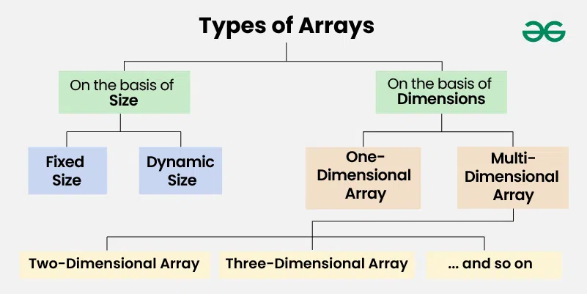
Types of Arrays

Slide 6
On the basis of size
1. Fixed Sized Arrays:
The size of a fixed-size array cannot be changed after creation.
Memory is allocated only for the size mentioned in square brackets [].
Declaring a larger size than needed wastes memory.
Declaring a smaller size than needed is not enough to store all elements.
Fixed-size arrays are not preferred when the number of elements is unknown.

Slide 7
On the basis of size
2. Dynamic Sized Arrays:
The size of a dynamic array can change during program execution.
Elements can be added or removed as needed.
Memory is allocated and de-allocated automatically.
Don’t need to worry about the array size in advance.
Dynamic arrays are flexible and useful when the number of elements is unknown.

Slide 8
On the basis of Dimensions
1. One-dimensional Array :
A 1-D array is a single row of elements stored in a sequence under one name.
Each element can be accessed using an index starting from 0.
It is used to store multiple values of the same type in a linear manner.
[5,8,6,8,1,3,8,6,4,72,762,456,1,3]

Slide 9
On the basis of Dimensions
2. Two-dimensional (2D) array (Matrix):
A 2-D array is like a table or grid with rows and columns.
Each element is accessed using two indices: one for the row and one for the column.
It is used to store multiple values of the same type in a matrix-like structure.
[[2,3],[3,6] – 2x2

Slide 10
On the basis of Dimensions
3. Three-dimensional array:
A 3-D array is like a stack of 2-D arrays, forming rows, columns, and layers.
Each element is accessed using three indices: for layer, row, and column.
It is used to store multiple values of the same type in a 3-dimensional structure.
[[[1,2],[2,3]],[[3,4],[5,6]]] 2x2x2

Slide 11
Strings
Strings are sequences of characters. The differences between a character array and a string are, a string is terminated with a special character ‘\0’ and strings are typically immutable in most of the programming languages like Java, Python and JavaScript.
C: Strings are declared as character arrays or pointers and must end with a null character (\0) to indicate termination.
C++: Supports both C-style character arrays and the std::string class, which provides built-in functions for string manipulation.
Java: Strings are immutable objects of the String class, meaning their values cannot be modified once assigned.
Python: Strings are immutable and can be declared using single, double, or triple quotes, making them flexible for multi-line text handling.
JavaScript: Strings are immutable, primitive data types and can be defined using single, double, or template literals (backticks), allowing for interpolation.
C#: Uses the string keyword, which represents an immutable sequence of characters, similar to Java.
There is no character type in Python and JavaScript and a single character is also considered as a string.

Slide 12
Strings
Are Strings Mutable in Different Languages?
In C/C++, string literals (assigned to pointers) are immutable.
In C++, string objects are mutable.
In Python, Java and JavaScript, strings are immutable.
# Create an immutable string
s = "GFG"
# This will cause a error
# because strings are immutable
s[1] = 'f'

Slide 13
Two Pointers Technique
The Two-Pointers Technique is a simple yet powerful strategy where you use two indices (pointers) that traverse a data structure - such as an array, list, or string - either toward each other or in the same direction to solve problems more efficiently
Two pointers is really an easy and effective technique that is typically used for Two Sum in Sorted Arrays, Closest Two Sum, Three Sum, Four Sum, Trapping Rain Water and many other popular interview questions.
Useful (or not) information: https://www.geeksforgeeks.org/dsa/two-pointers-technique/

Slide 14
When to use two pointers
Sorted Input : If the array or list is already sorted (or can be sorted), two pointers can efficiently find pairs or ranges. Example: Find two numbers in a sorted array that add up to a target.
Pairs or Subarrays : When the problem asks about two elements, subarrays, or ranges instead of working with single elements. Example: Longest substring without repeating characters, maximum consecutive ones, checking if a string is palindrome.
Sliding Window Problems : When you need to maintain a window of elements that grows/shrinks based on conditions. Example: Find smallest subarray with sum ≥ K, move all zeros to end while maintaining order.
Linked Lists (Slow–Fast pointers) : Detecting cycles, finding the middle node, or checking palindrome property. Example: Floyd’s Cycle Detection Algorithm (Tortoise and Hare).

Slide 15
Example
Given a sorted array arr (sorted in ascending order) and a target, find if there exists any pair of elements (arr[i], arr[j]) such that their sum is equal to the target.
Input: arr[] = [10, 20, 35, 50], target =70
Output: true
Explanation : There is a pair (20, 50) with given target.
Input: arr[] = [10, 20, 30], target =70
Output : false
Explanation : There is no pair with sum 70
Input: arr[] = [-8, 1, 4, 6, 10, 45], target = 16
Output: true
Explanation : There is a pair (6, 10) with given target.

Slide 16
Example
  # Function to check whether any pair exists O(N^2)
  # whose sum is equal to the given target value
  def two_sum(arr, target):
  n = len(arr)
  # Iterate through each element in the array
  for i in range(n): # N
  # For each element arr[i], check every
  # other element arr[j] that comes after it
  for j in range(i + 1, n): # N = N^2
  # Check if the sum of the current pair
  # equals the target
  if arr[i] + arr[j] == target:
  return True
  # If no pair is found after checking
  # all possibilities
  return False
  arr = [0, -1, 2, -3, 1]
  target = -2
  # Call the two_sum function and print the result
  if two_sum(arr, target):
  print("true")
  else:
  print("false")

Slide 17
Example
  # Function to check whether any pair exists O(n)
  # whose sum is equal to the given target value
  def two_sum(arr, target):
  # Sort the array
  left, right = 0, len(arr) - 1
  # Iterate while left pointer is less than right
  while left < right:
  sum = arr[left] + arr[right]
  # Check if the sum matches the target
  if sum == target:
  return True
  elif sum < target:
  left += 1 # Move left pointer to the right
  else:
  right -= 1 # Move right pointer to the left
  # If no pair is found
  return False
  arr = [-3, -1, 0, 1, 2]
  target = -2
  # Call the two_sum function and print the result
  if two_sum(arr, target):
  print("true")
  else:
  print("false")

Slide 18
Sliding Window Technique
Sliding Window Technique is a method used to solve problems that involve subarray or substring or window.
Instead of repeatedly iterating over the same elements, the sliding window maintains a range (or “window”) that moves step-by-step through the data, updating results incrementally.
The main idea is to use the results of previous window to do computations for the next window.
Commonly used for problems like finding subarrays with a specific sum, finding the longest substring with unique characters, or solving problems that require a fixed-size window to process elements efficiently.
More useful (or not) information: https://www.geeksforgeeks.org/dsa/window-sliding-technique/

Slide 19
Example 2
Given an array arr[] and an integer k, we need to calculate the maximum sum of a subarray having size exactly k.
Input : arr[] = [5, 2, -1, 0, 3], k = 3
Output : 6
Explanation : We get maximum sum by considering the subaarray [5, 2 , -1]
Input : arr[] = [1, 4, 2, 10, 23, 3, 1, 0, 20], k = 4
Output : 39
Explanation : We get maximum sum by adding subarray [4, 2, 10, 23] of size 4.

Slide 20
Example 2
  import sys # O(n*k)
  def maxSum(arr, n, k):
  # Initialize result
  max_sum = -sys.maxsize
  # Consider all blocks starting with i.
  for i in range(n - k + 1):
  current_sum = 0
  for j in range(k):
  current_sum += arr[i + j]
  # Update result if required.
  max_sum = max(current_sum, max_sum)
  return max_sum
  if __name__ == "__main__":
  arr = [5, 2, -1, 0, 3]
  k = 3
  n = len(arr)
  print(maxSum(arr, n, k))

Slide 21
Example 2
  def maxSum(arr, k): # O(n)
  # length of the array
  n = len(arr)
  # n must be greater than k
  if n <= k:
  print("Invalid")
  return -1
  # Compute sum of first window of size k
  window_sum = sum(arr[:k])
  # first sum available
  max_sum = window_sum
  # Compute the sums of remaining windows by removing first element of previous
  # window and adding last element of the current window.
  for i in range(n - k):
  window_sum = window_sum - arr[i] + arr[i + k]
  max_sum = max(window_sum, max_sum)
  return max_sum
  if __name__ == "__main__":
  arr = [5, 2, -1, 0, 3]
  k = 3
  print(maxSum(arr, k))

